Slide 1

Automating Apache Deployment using GitHub Actions + Ansible
Tools: GitHub Actions, Ansible, Oracle VirtualBox

Slide 2
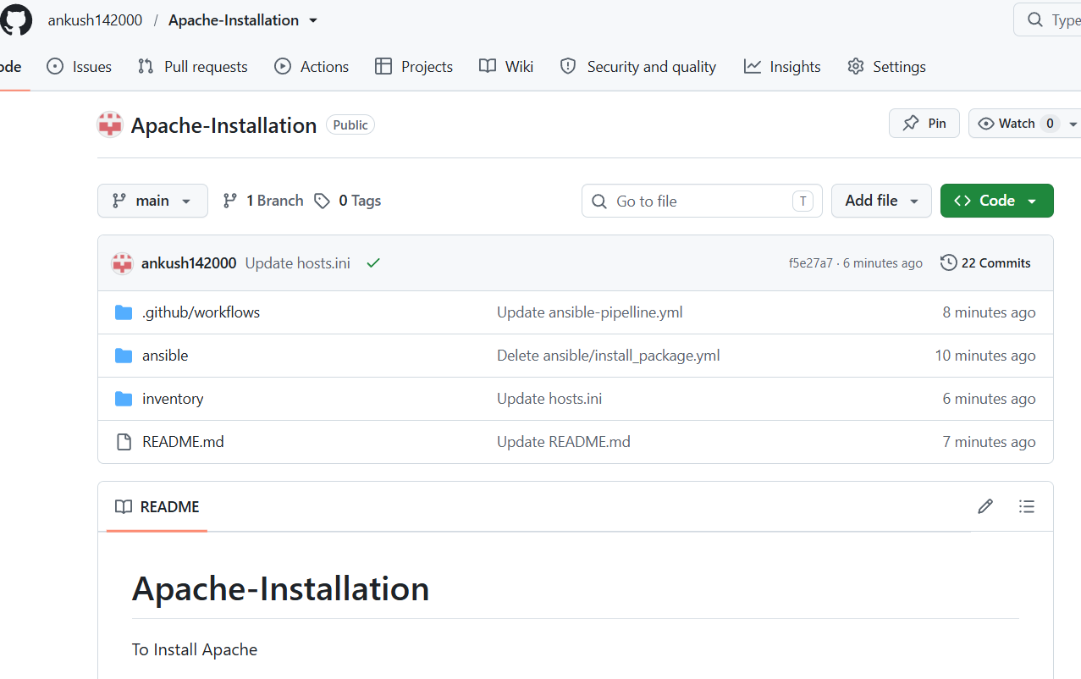
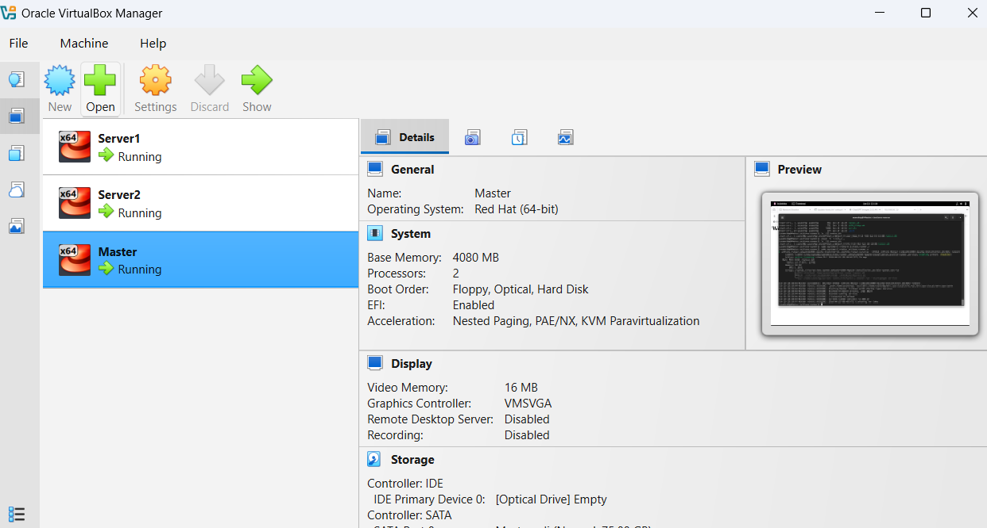
Tools & Environment Oracle VirtualBox → Local Linux VMs GitHub → Repo + CI/CD pipeline Ansible → Automation engine Self‑Hosted Runner → Connect GitHub Actions to local servers

Slide 3
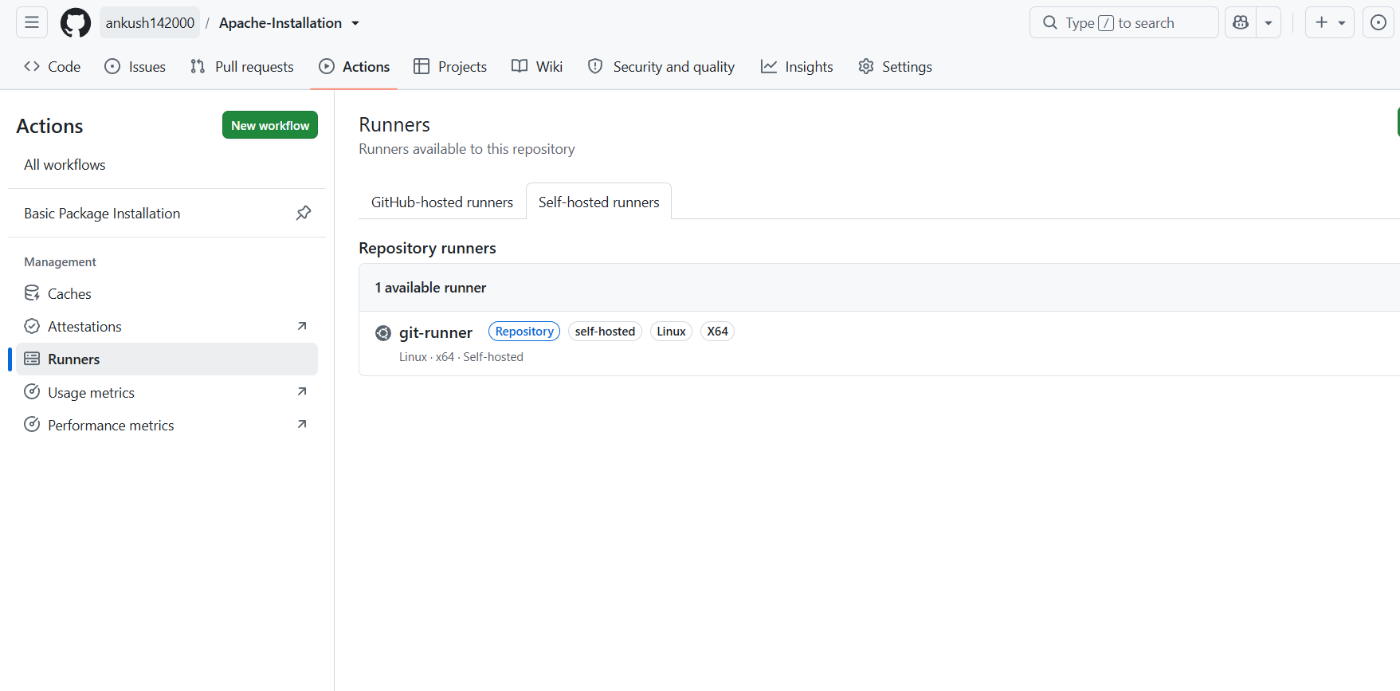
Configuring Self-Hosted Runner

Slide 4
Workflow Diagram
Update Server list in inventory file → GitHub repo
GitHub Actions pipeline triggers
Runner executes Ansible playbook
Apache installed + homepage deployed on servers

Slide 5

Implementation Steps
Created Ansible playbook (configure_apache.yml)
Updated Inventory file
Configured self‑hosted runner on VM
Pipeline runs automatically on push

Slide 6
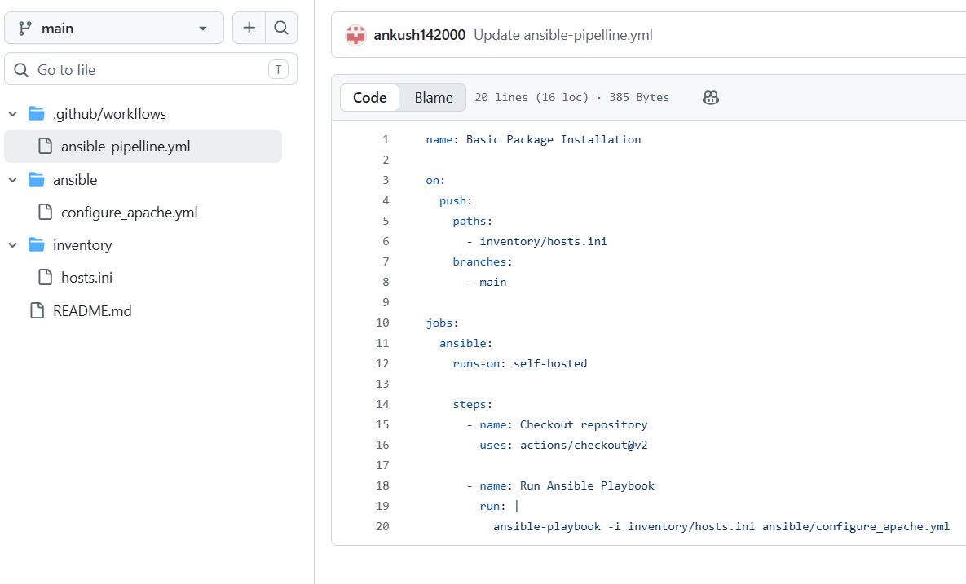
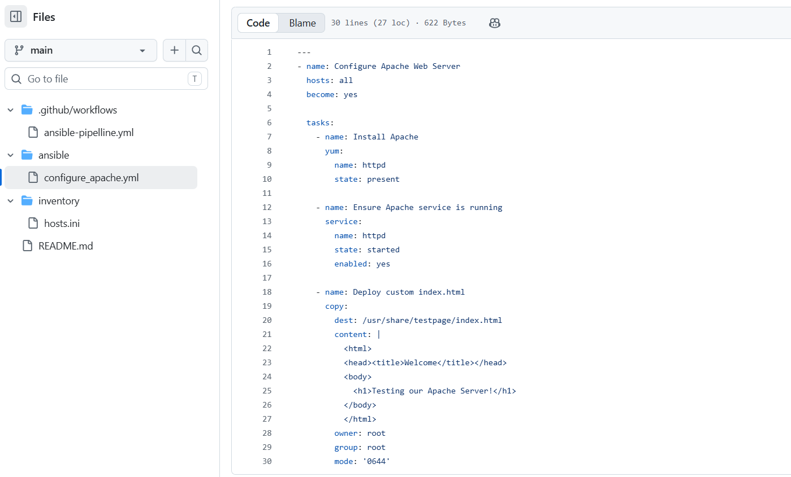
Workflow file and Ansible Playbook

Slide 7
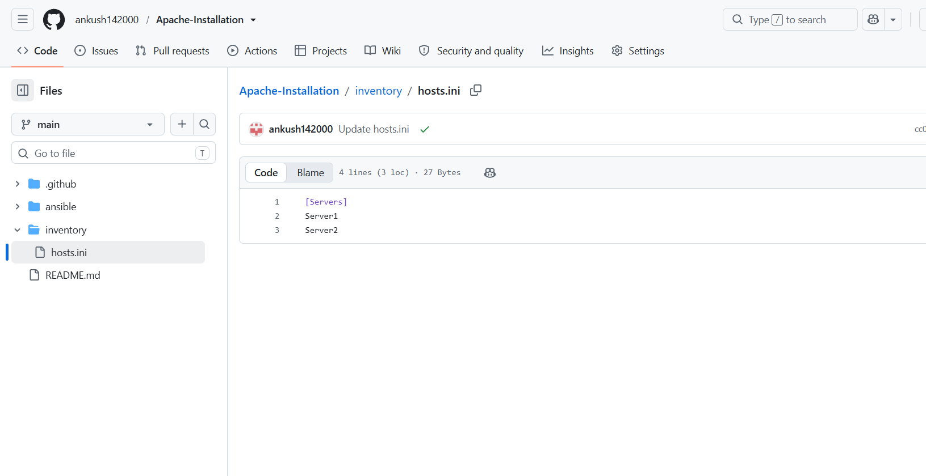
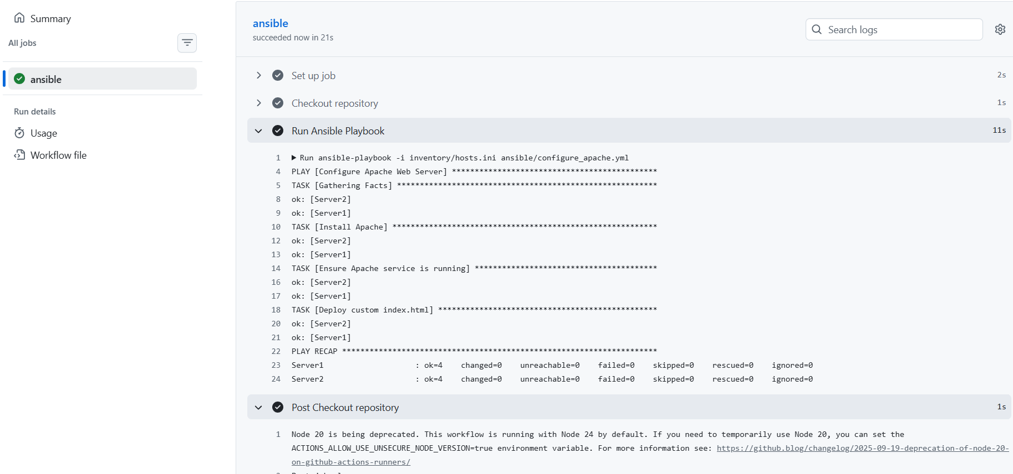
Results

Slide 8
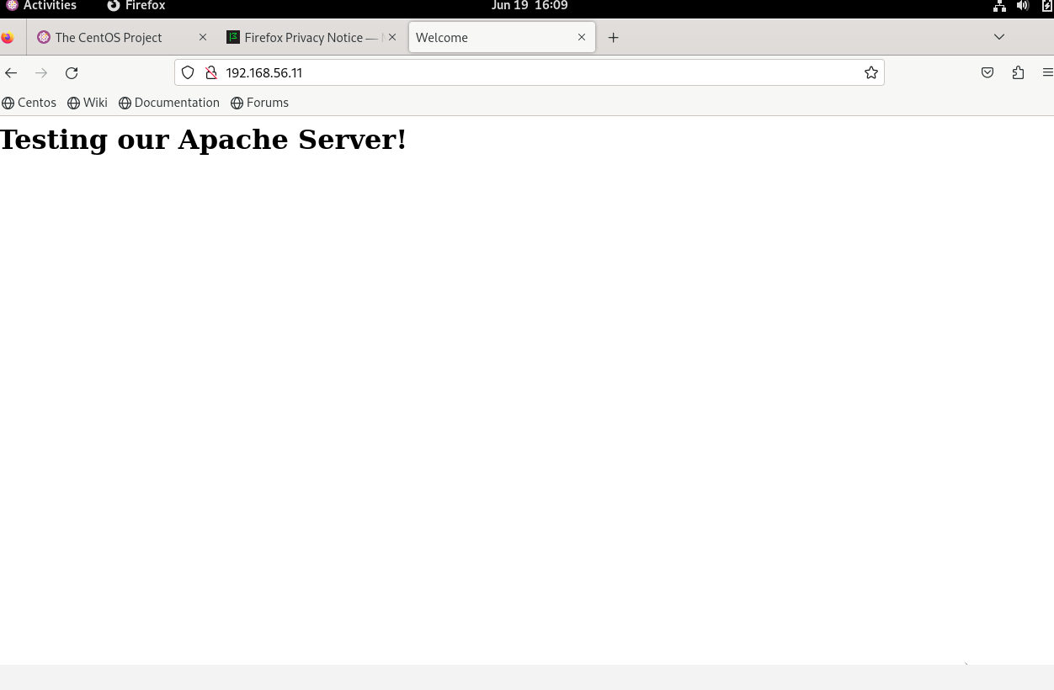
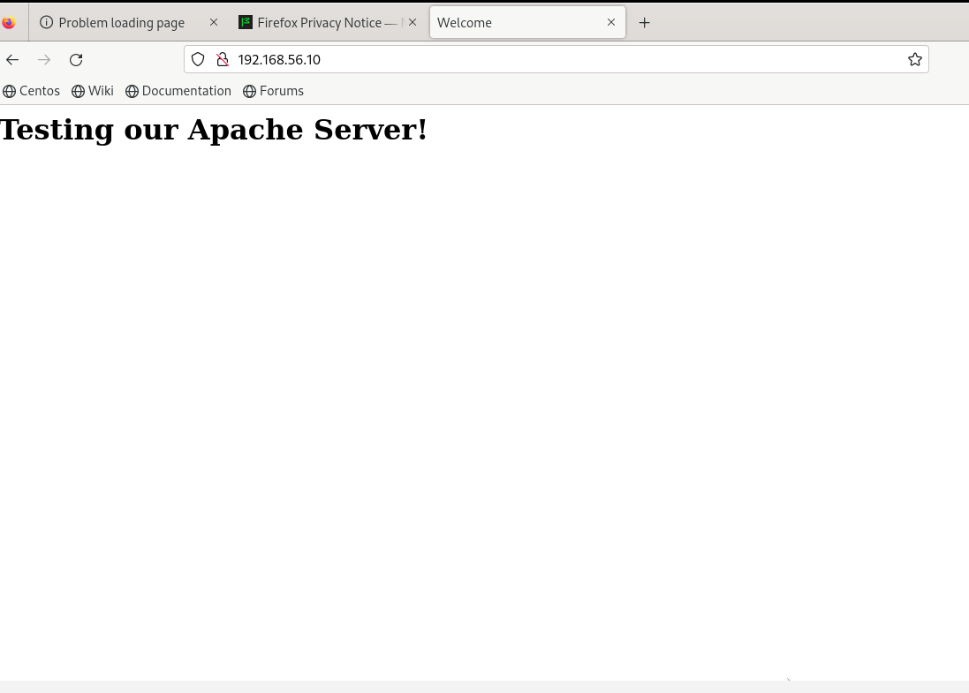
Apache Deployment Result on Target Servers:

